Slide 1
University of Basrah Al-zahraa medical college
Ministry of higher Education and Scientific Researches
The module: Tissue of the Body (TOB)
Session 8 Lecture 1
Bone
Module staff: Dr. Ihsan Mardan
Dr. Nada Hashim
Dr. Nibras Saleam
Dr. Wafaa Abdul-Kareem
Dr. Rasha Sabah
Dr. Hussein K. Abdel-Sada
Dr. Falih Waheed
Dr. Majid Alabood
Dr. Raid
Dr. Sadiq Ali
Color Atlas and Text of Histology, sixth edition.
WHEATER’S Functional Histology, A Text and Colour Atlas, Sixth edition.
For more detailed instruction, any question, cases need help please post to the group of session.

Slide 2
Intended learning outcomes of this lecture:
At the end of this lecture you should be able to know :
describe the characteristic features and functions of the different types of bone in the body. LO1
recognize, and classify bone as compact (dense) or spongy (cancellous/trabecular). LO2
describe the composition of bone in terms of its cells and extracellular components. LO3
describe the microstructure of compact (dense) and spongy (cancellous/trabecular) bone. LO4

Slide 3
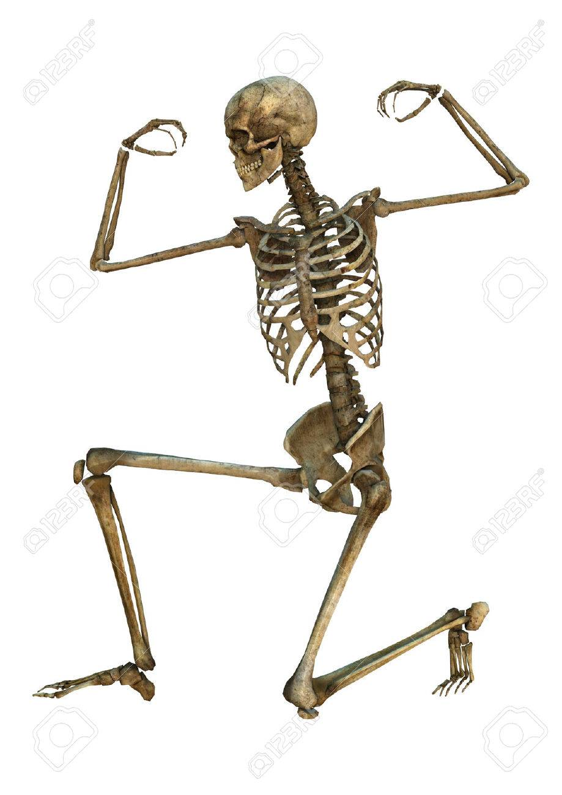
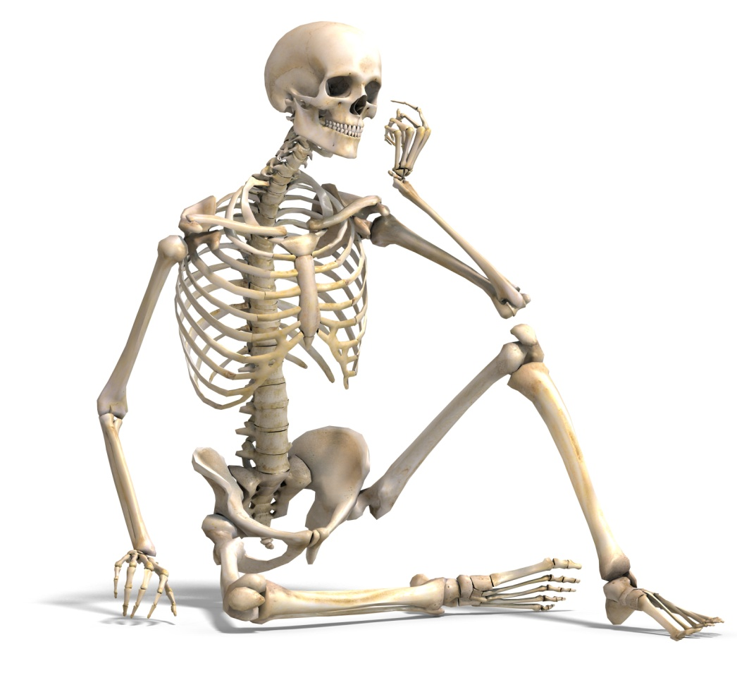
LO1
Bone is a vascular connective tissue consisting of cells and calcified extracellular materials, known as the matrix. It is well supplied with blood vessels, lymphatics and nerves.
Bone has numerous functions such as,
Support - bones make up a structural framework for the body, and provide attachment sites for muscles.
Protection - protection of internal organs - i.e. brain, heart and lungs.
Assisting movement.
Mineral homeostasis - the bone is a store for calcium and phosphorus.
Blood cell production - takes place in the bone marrow.

Slide 4
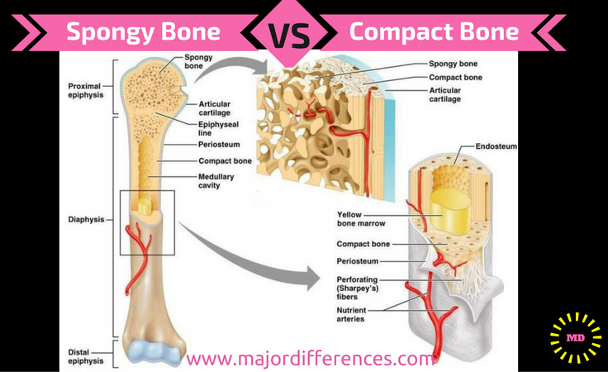
LO2
Two kinds of bone tissue, of different porosity, are found in the body:
Compact (dense) bone is hard and forms the outer layer of bones.
Spongy (cancellous) bone is found deeper and is porous and highly vascular.
The appearance of compact and spongy bone is due to the organisation of bone cells, fibres and the matrix in association with other elements, such as blood vessels, lymphatics and bone marrow.

Slide 5
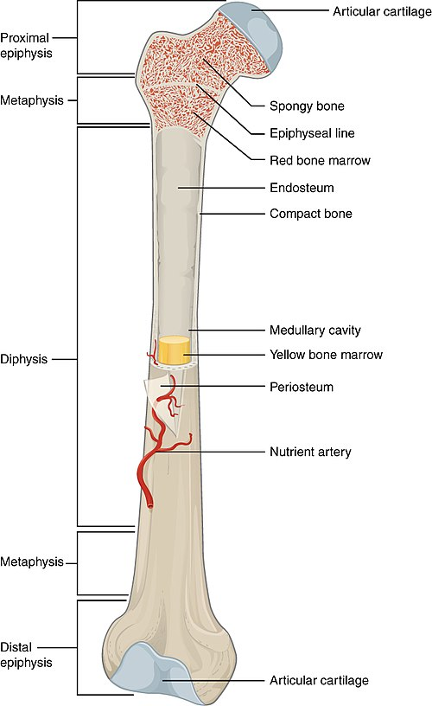
In adults:
The diaphysis is cylindrical with walls of compact bone and a central marrow cavity lined with endosteum.
The epiphysis contains mostly spongy bone.
Where bones contact other bones to form movable joints, their surfaces are covered by articular (Hyaline) cartilage.

Slide 6
LO3
Bone Matrix and Cells
Bone matrix contains organic components (osteoid), and inorganic components (bone mineral).
The organic components constitutes about 50% of bone volume and 25% of bone weight. It is composed of type I collagen fibres and unmineralized ground substance, which is composed of proteins, carbohydrates, and small amounts of proteoglycans and lipids.
The inorganic components (bone mineral) makes up about 50% of bone volume and 75% of bone weight. It is composed of calcium and phosphate, with some bicarbonate, citrate, magnesium and potassium and trace amounts of other metals.

Slide 7
LO3
Bone matrix continue.....
If you removed all the organic matrix (collagen) from a bone, it would crumble and shatter readily.
Conversely, if you remove all the inorganic matrix (minerals) from bone and leave the collagen, the bone becomes overly flexible and cannot bear weight.

Slide 8
LO3
Bone Cells: Although bone cells compose less than 2% of the bone mass, they are crucial to the function of bones.
Four types of cells are found within bone tissue: osteoblasts, osteocytes, osteogenic cells, and osteoclasts
The osteoblast:
It is the bone cell responsible for forming new bone and is found in the growing portions of bone, including the endosteum and the cellular layer of the periosteum.
They are large rounded or cuboidal cells, with deep basophilic cytoplasm, They synthesize and secrete all the organic components of bone matrix.

Slide 9
LO3
As the secreted matrix surrounding the osteoblast calcifies, the osteoblast become trapped within it; as a result, it changes in structure and becomes an osteocyte;
The primary cell of mature bone and the most common type of bone cell, each osteocyte is located in a small cavity in the bone tissue called a lacuna (lacunae for plural).
Osteocytes maintain the mineral concentration of the matrix.
They can communicate with each other and receive nutrients via long cytoplasmic processes that extend through canaliculi.

Slide 10
LO3
Osteogenic (osteoprogenitor) cells:
Undifferentiated with high mitotic activity.
Immature osteogenic cells are found in the cellular layer of the periosteum and the endosteum.
They are small spindle-shaped cells with pale cytoplasm and ovoid nuclei.
Osteoclasts:
Osteoclasts are bone-resorbing cells that lie on bony surfaces in shallow depressions called Howship's lacunae.

Slide 11
LO3
Osteoclasts are large multinucleated cells (~50 nuclei), with acidophilic cytoplasm containing abundant lysosomes and mitochondria and well developed Golgi complex.
They are derived from the fusion of blood monocyte derivatives and are considered components of the mononuclear phagocyte system.
The cells release acid, collagenase, and other lytic enzymes into the compartments; these break down bone matrix and release minerals, a process called bone resorption.

Slide 12
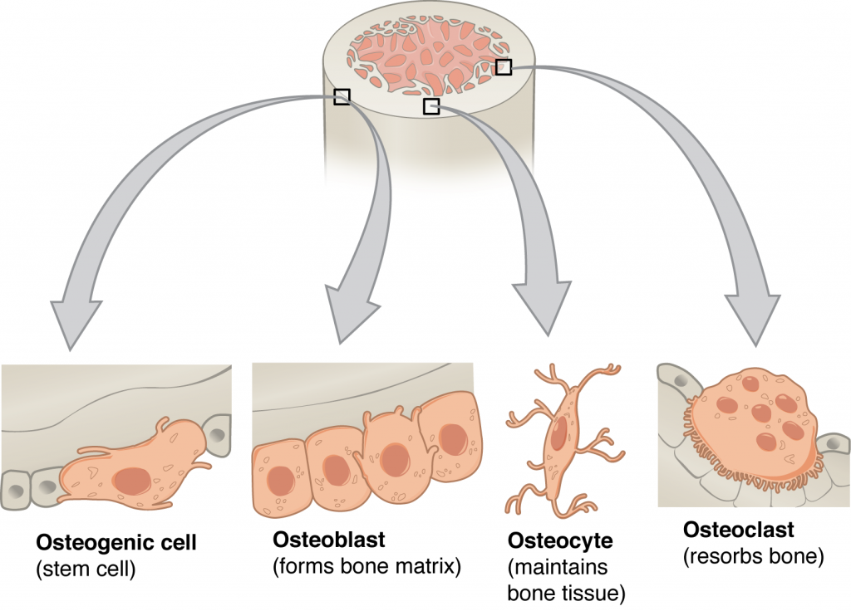
LO6

Slide 13
LO4
Surfaces:
The outer surfaces of bones are covered by two layers of connective tissue (periosteum).
outer fibrous layer consisting mainly of collagen fibres and populated by fibroblasts.
inner osteogenic layer consists of some collagen fibres and mostly osteoprogenitor cells and their progeny, the osteoblasts. The periosteum is affixed to bone via Sharpey’s fibres (collagenous bundles trapped in the calcified bone matrix during ossification).
The marrow cavity is lined by an endosteum composed of osteoprogenitor, osteoblasts, and occasional osteoclasts.

Slide 14
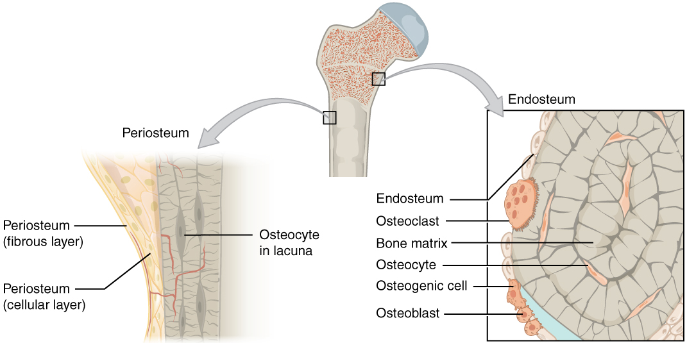

Slide 15
Compact Bone
Periosteum: covering the long bone, and formed of two layers:-
Outer fibrous layer of collagen fibres.
Inner cellular layer of osteogenic cells and osteoblasts.
Endosteum: a cellular layer lining the bone cavities, and formed of osteogenic cells and osteoblasts.
Haversian system (osteon): Bone lamellae are arranged concentrically around the blood vessels. The bone lamellae are formed of osteocytes inside lacunae and canaliculi embedded in calcified matrix.
Volkmann`s Canals: They are transverse canals connecting blood vessels in the Haversian canals to each other and to those in the periosteum and in marrow cavities.
External circumferential lamellae.
Internal circumferential lamellae.
Interstitial lamellae.
LO4

Slide 16
LO4
Spongy or cancellous bone
Spongy bone forms a fine 3-dimensional lattice with many bony cavities, with branching and anastomosing slips of bone between the cavities, called trabeculae.
Spongy bone is found at the core of the epiphysis of mature long bones, at the core of short bones, and between the thick plates, or tables, of the flat bones of the skull, where it is called the diploii.

